Slide 1

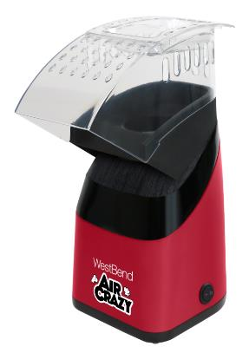
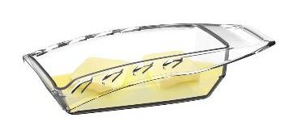
Air Crazy Popcorn Maker, Red
ITEM / INT’L / MODEL # | DESCRIPTION | UPC# | MASTER GTIN#
PC8448RD13 | Air Crazy Popcorn Maker, Red | 072244000054 | 20072244000058
SPECIFICATIONS | Width (in) (cm) |  | Depth (in) (cm) |  | Height (in) (cm) |  | Cube (in) (cm) |  | Weight (lbs.) (kg)
Product | 5.52 | 14 | 9.65 | 24.5 | 12.41 | 31.5 |  |  | 2.01 | 0.91
Retail Box | 5.83 | 14.8 | 9.65 | 24.5 | 10.4 | 26.4 |  |  | 2.84 | 1.29
Master Carton | 10.43 | 26.49 | 12.84 | 32.59 | 11.62 | 29.49 |  |  | 7 | 3
 | QTY
Case Pack | 2
Ti-Hi | 12/4
FEATURES & BENEFITS
Pops up to 4-quart of healthy delicious popcorn in 3 minutes Quick and easy clean Heat resistant plastic in top chute Ventilation for more and faster cooling Longer butter melting tray helps with more even butter distribution Butter tray also doubles as a measuring cup Built-in cord storage On/Off switch
Wattage | 1400
Testing Approvals
Warranty | 1 year
SPECIFICATIONS SUBJECT TO CHANGE WITHOUT NOTICE.
www.westbend.com
©2020 The Legacy Companies. All Rights Reserved.
R1_2020

Slide 2

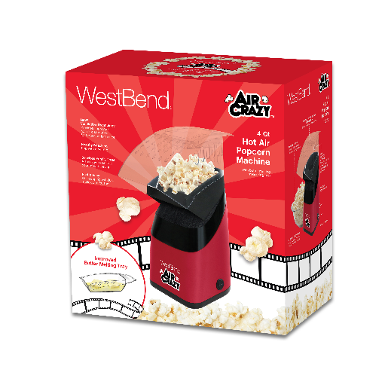
Air Crazy Popcorn Maker, Red
FEATURES & BENEFITS
Pops up to 4-quart of healthy delicious popcorn in 3 minutes Quick and easy clean Heat resistant plastic in top chute Ventilation for more and faster cooling Longer butter melting tray helps with more even butter distribution Butter tray also doubles as a measuring cup Built-in cord storage On/Off switch
PRODUCT DETAIL
• Model #: PC8448RD13
• SRP: $ 19.99
• Invoice Cost: $ 14.00
SPECIFICATIONS SUBJECT TO CHANGE WITHOUT NOTICE.
www.westbend.com
©2020 The Legacy Companies. All Rights Reserved.
R1_2020

