Slide 1

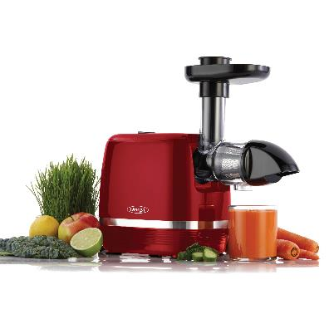
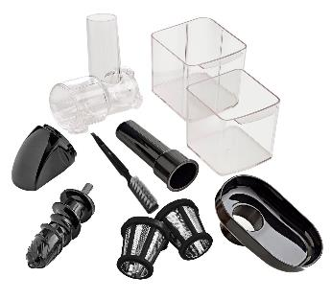

H3000RED Slow Juicer
ITEM / INT’L / MODEL # | DESCRIPTION | UPC# | MASTER GTIN#
H3000RED | Slow Juicer | 737416001641 | 10037416001649
SPECIFICATIONS | Width (in) (mm) |  | Depth (in) (mm) |  | Height (in) (mm) |  | Cube (in) (mm) |  | Weight (lbs.) (kg)
Product | 6.7 | 17 | 17.96 | 45.6 | 13.27 | 33.7 |  |  | 8.76 | 3.98
Retail Box | 9.13 | 23.2 | 16.93 | 43 | 11.3 | 28.7 |  |  | 9.94 | 4.52
Master Carton | 9.65 | 24.5 | 17.52 | 44.5 | 12.09 | 30.7 |  |  | 9.94 | 5.02
 | QTY
Case Pack | 1
Ti-Hi | 10/4
FEATURES & BENEFITS
Low speed, masticating, 90-110 RPM Reverse function Small footprint for easy storage Quiet operation Anti-Clog reverse function for fast and smooth juice extraction BPA free Includes dishwasher safe pulp and juice container
Wattage | 150W
Testing Approvals
Warranty | 1 year
SPECIFICATIONS SUBJECT TO CHANGE WITHOUT NOTICE.
www.omega.com
©2020 The Legacy Companies. All Rights Reserved.
R1_2020

Slide 2

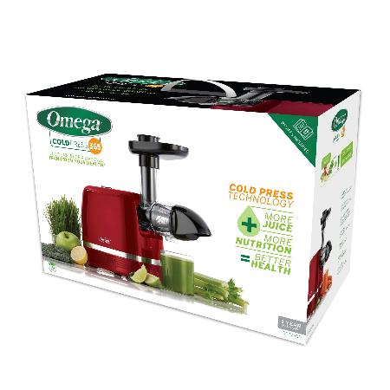
H3000RED Slow Juicer
FEATURES & BENEFITS
Low speed, masticating, 90-110 RPM Reverse function Small footprint for easy storage Quiet operation Anti-Clog reverse function for fast and smooth juice extraction BPA free Includes dishwasher safe pulp and juice container
PRODUCT DETAIL
• Model #: H3000RED
• SRP: $ 149.99
• Invoice Cost: $ 105.00
SPECIFICATIONS SUBJECT TO CHANGE WITHOUT NOTICE.
www.omega.com
©2020 The Legacy Companies. All Rights Reserved.
R1_2020

