Slide 1
Place Company Logo Here
Delete Gray Box
BUILDING NAME
© 2016 Rubbermaid Commercial Products LLC

Slide 2
AGENDA
Place Company Logo Here
Delete Gray Box
RECYCLING OVERVIEW
WASTE AUDIT RESULTS
NEW SYSTEM INTRODUCTION

Slide 3
WHY RECYCLE?
Place Company Logo Here
Delete Gray Box

Slide 4
WASTE AUDIT RESULTS
Place Company Logo Here
Delete Gray Box
STREAMS
AVG. WEIGHT (IN LBS.)
CURRENT
FUTURE
6%
58%
DIVERSION
RATE
POSSIBLE
DIVERSION
RATE
US NATIONAL
RATE = 34%
Notes:
Right click on charts to update data in Excel.

Slide 5
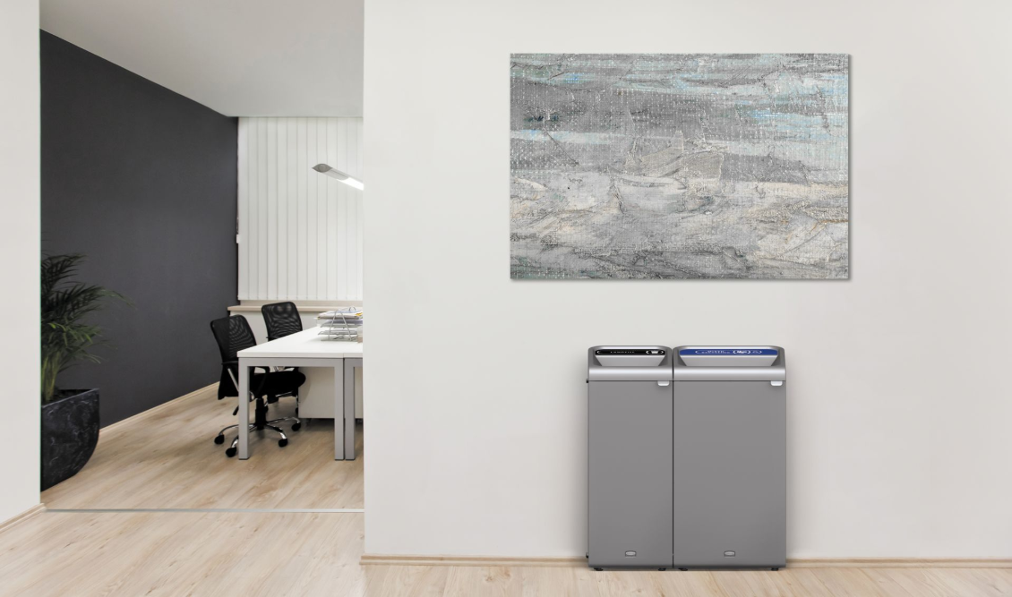
WASTE STREAMS COLLECTED
Place Company Logo Here
Delete Gray Box
INSTRUCTION: Update this slide to include the labels/streams for your facility

Slide 6
AROUND THE OFFICE
Place Company Logo Here
Delete Gray Box
INSTRUCTION: Pull images from Appendix to populate for your facility
FILL-IN AREA 1
FILL-IN AREA 2
FILL-IN AREA 3

Slide 7
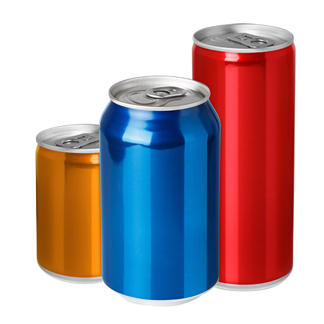
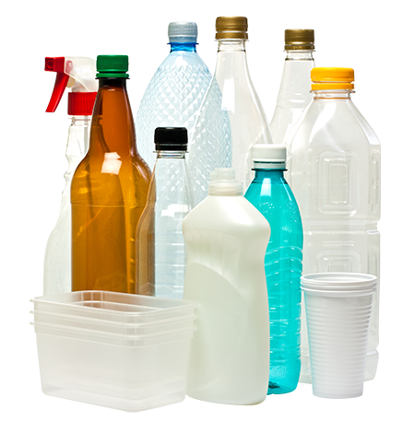
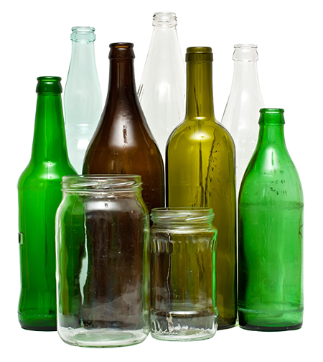
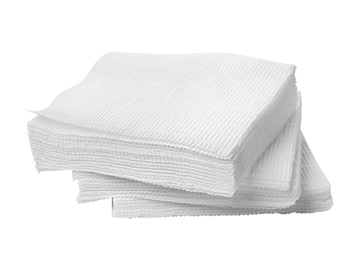
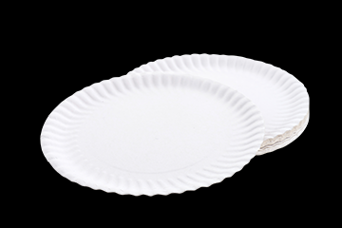
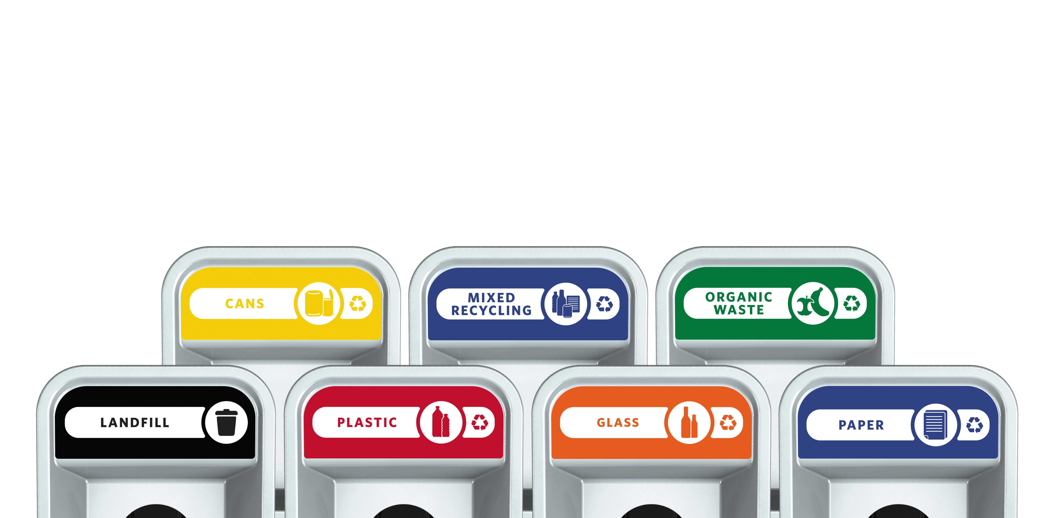
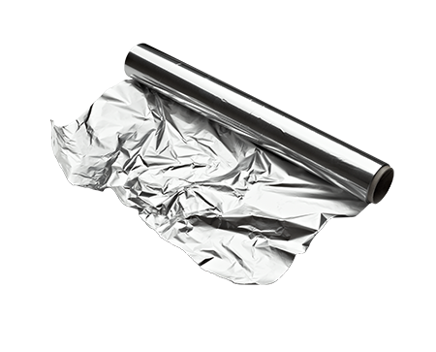
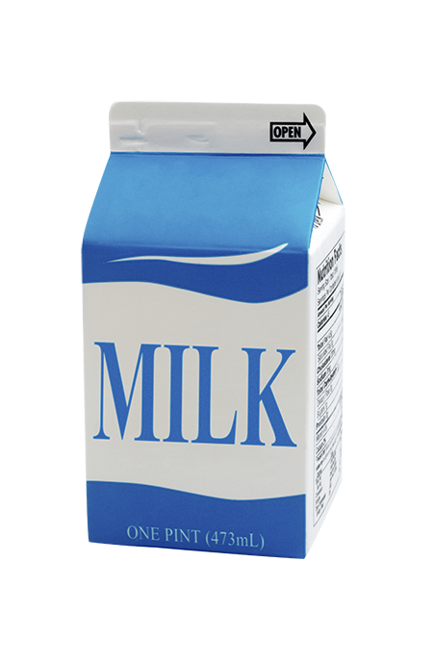
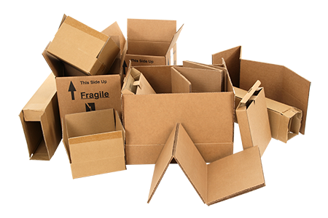
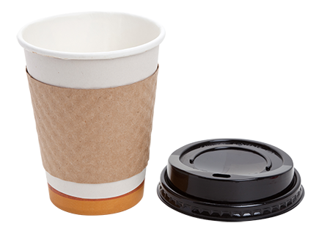
WHAT CAN BE RECYCLED?
Place Company Logo Here
Delete Gray Box
ALUMINUM CANS
PLASTIC BOTTLES
GLASS BOTTLES
UNSOILED
PAPER TOWELS
UNSOILED NAPKINS
UNSOILED PAPER PLATES
PAPER
CARDBOARD
MAGAZINES
ALUMINUM FOIL
PAPER CARTONS
UNSOILED COFFEE CUPS

Slide 8
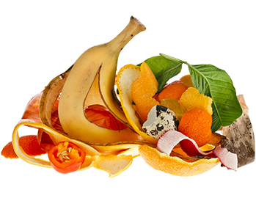
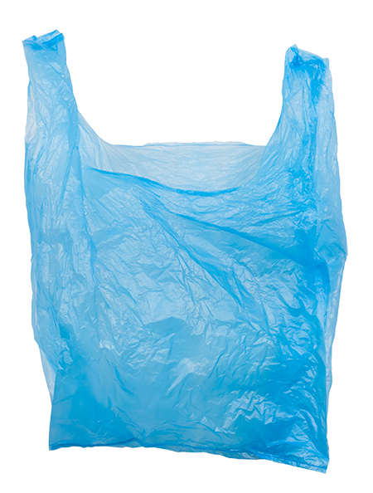
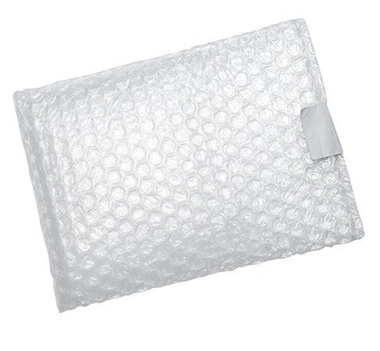
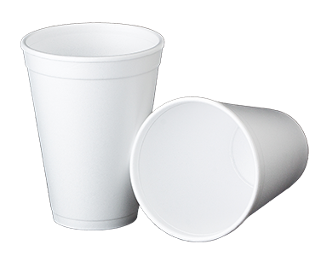
WHAT SHOULD BE THROWN AWAY?
Place Company Logo Here
Delete Gray Box
FOOD*
PLASTIC BAGS*
PLASTIC WRAP*
COFFEE CUP LIDS*
STYROFOAM*
*If hauler does not accept

Slide 9
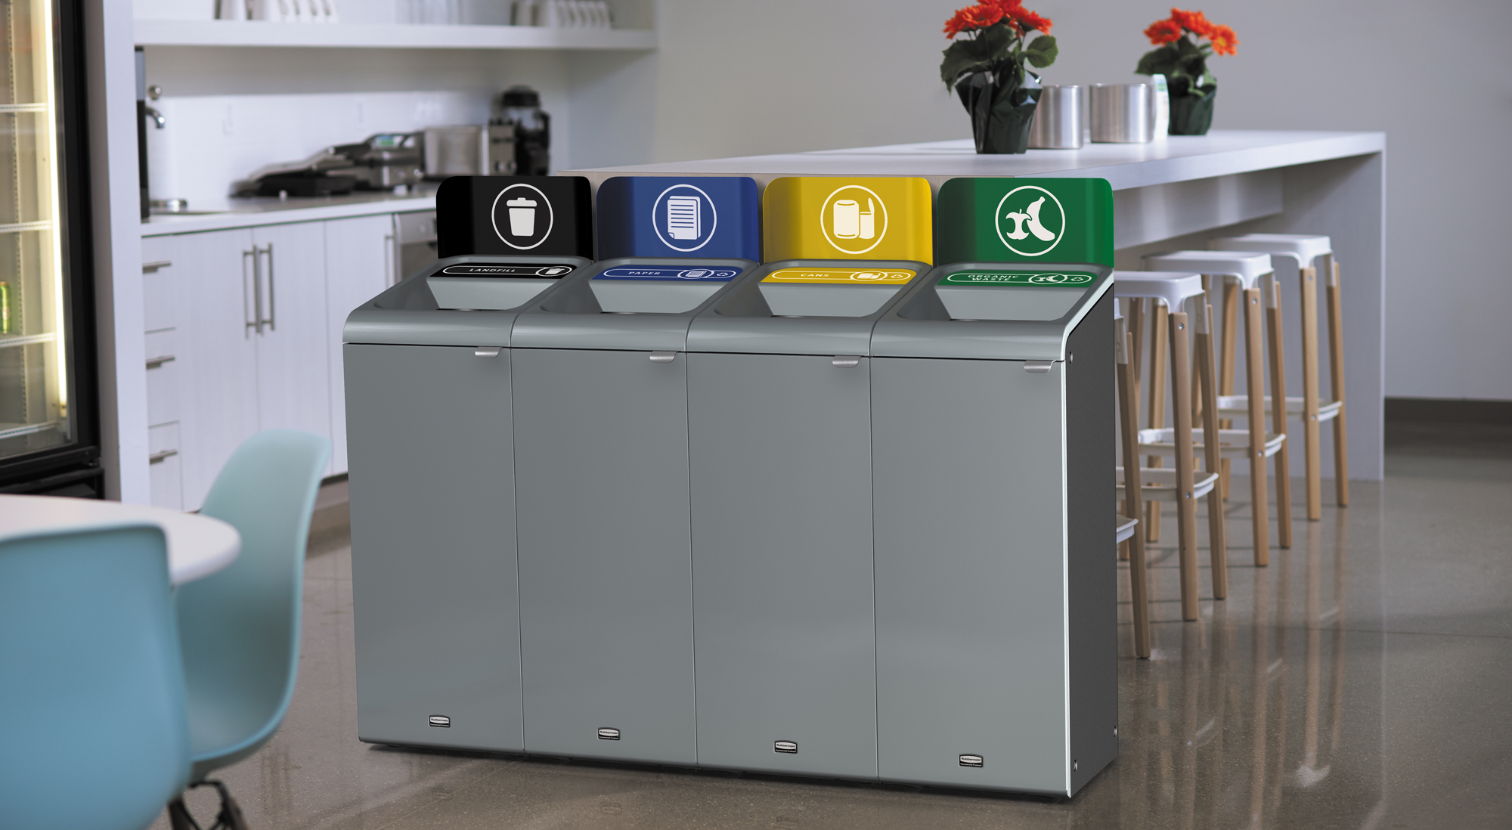
APPENDIX
Place Company Logo Here
Delete Gray Box

Slide 10
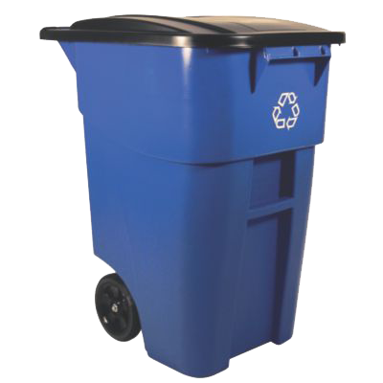
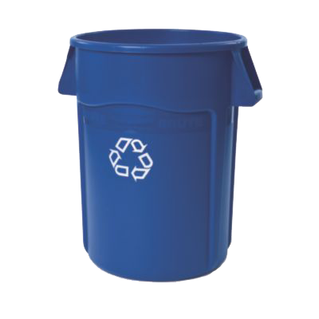
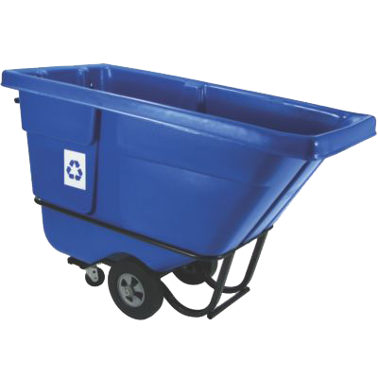
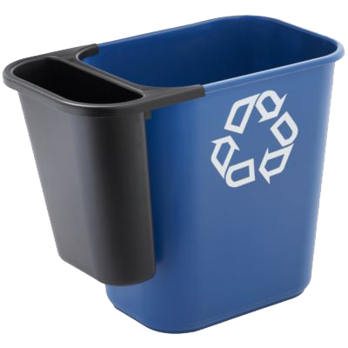
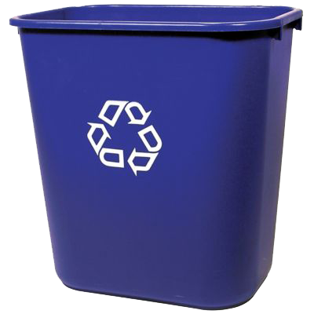
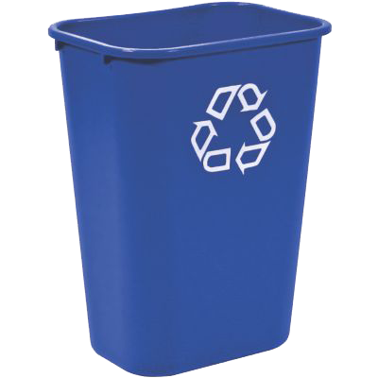
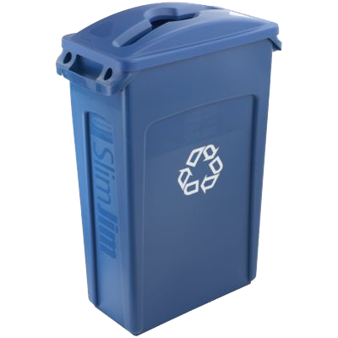
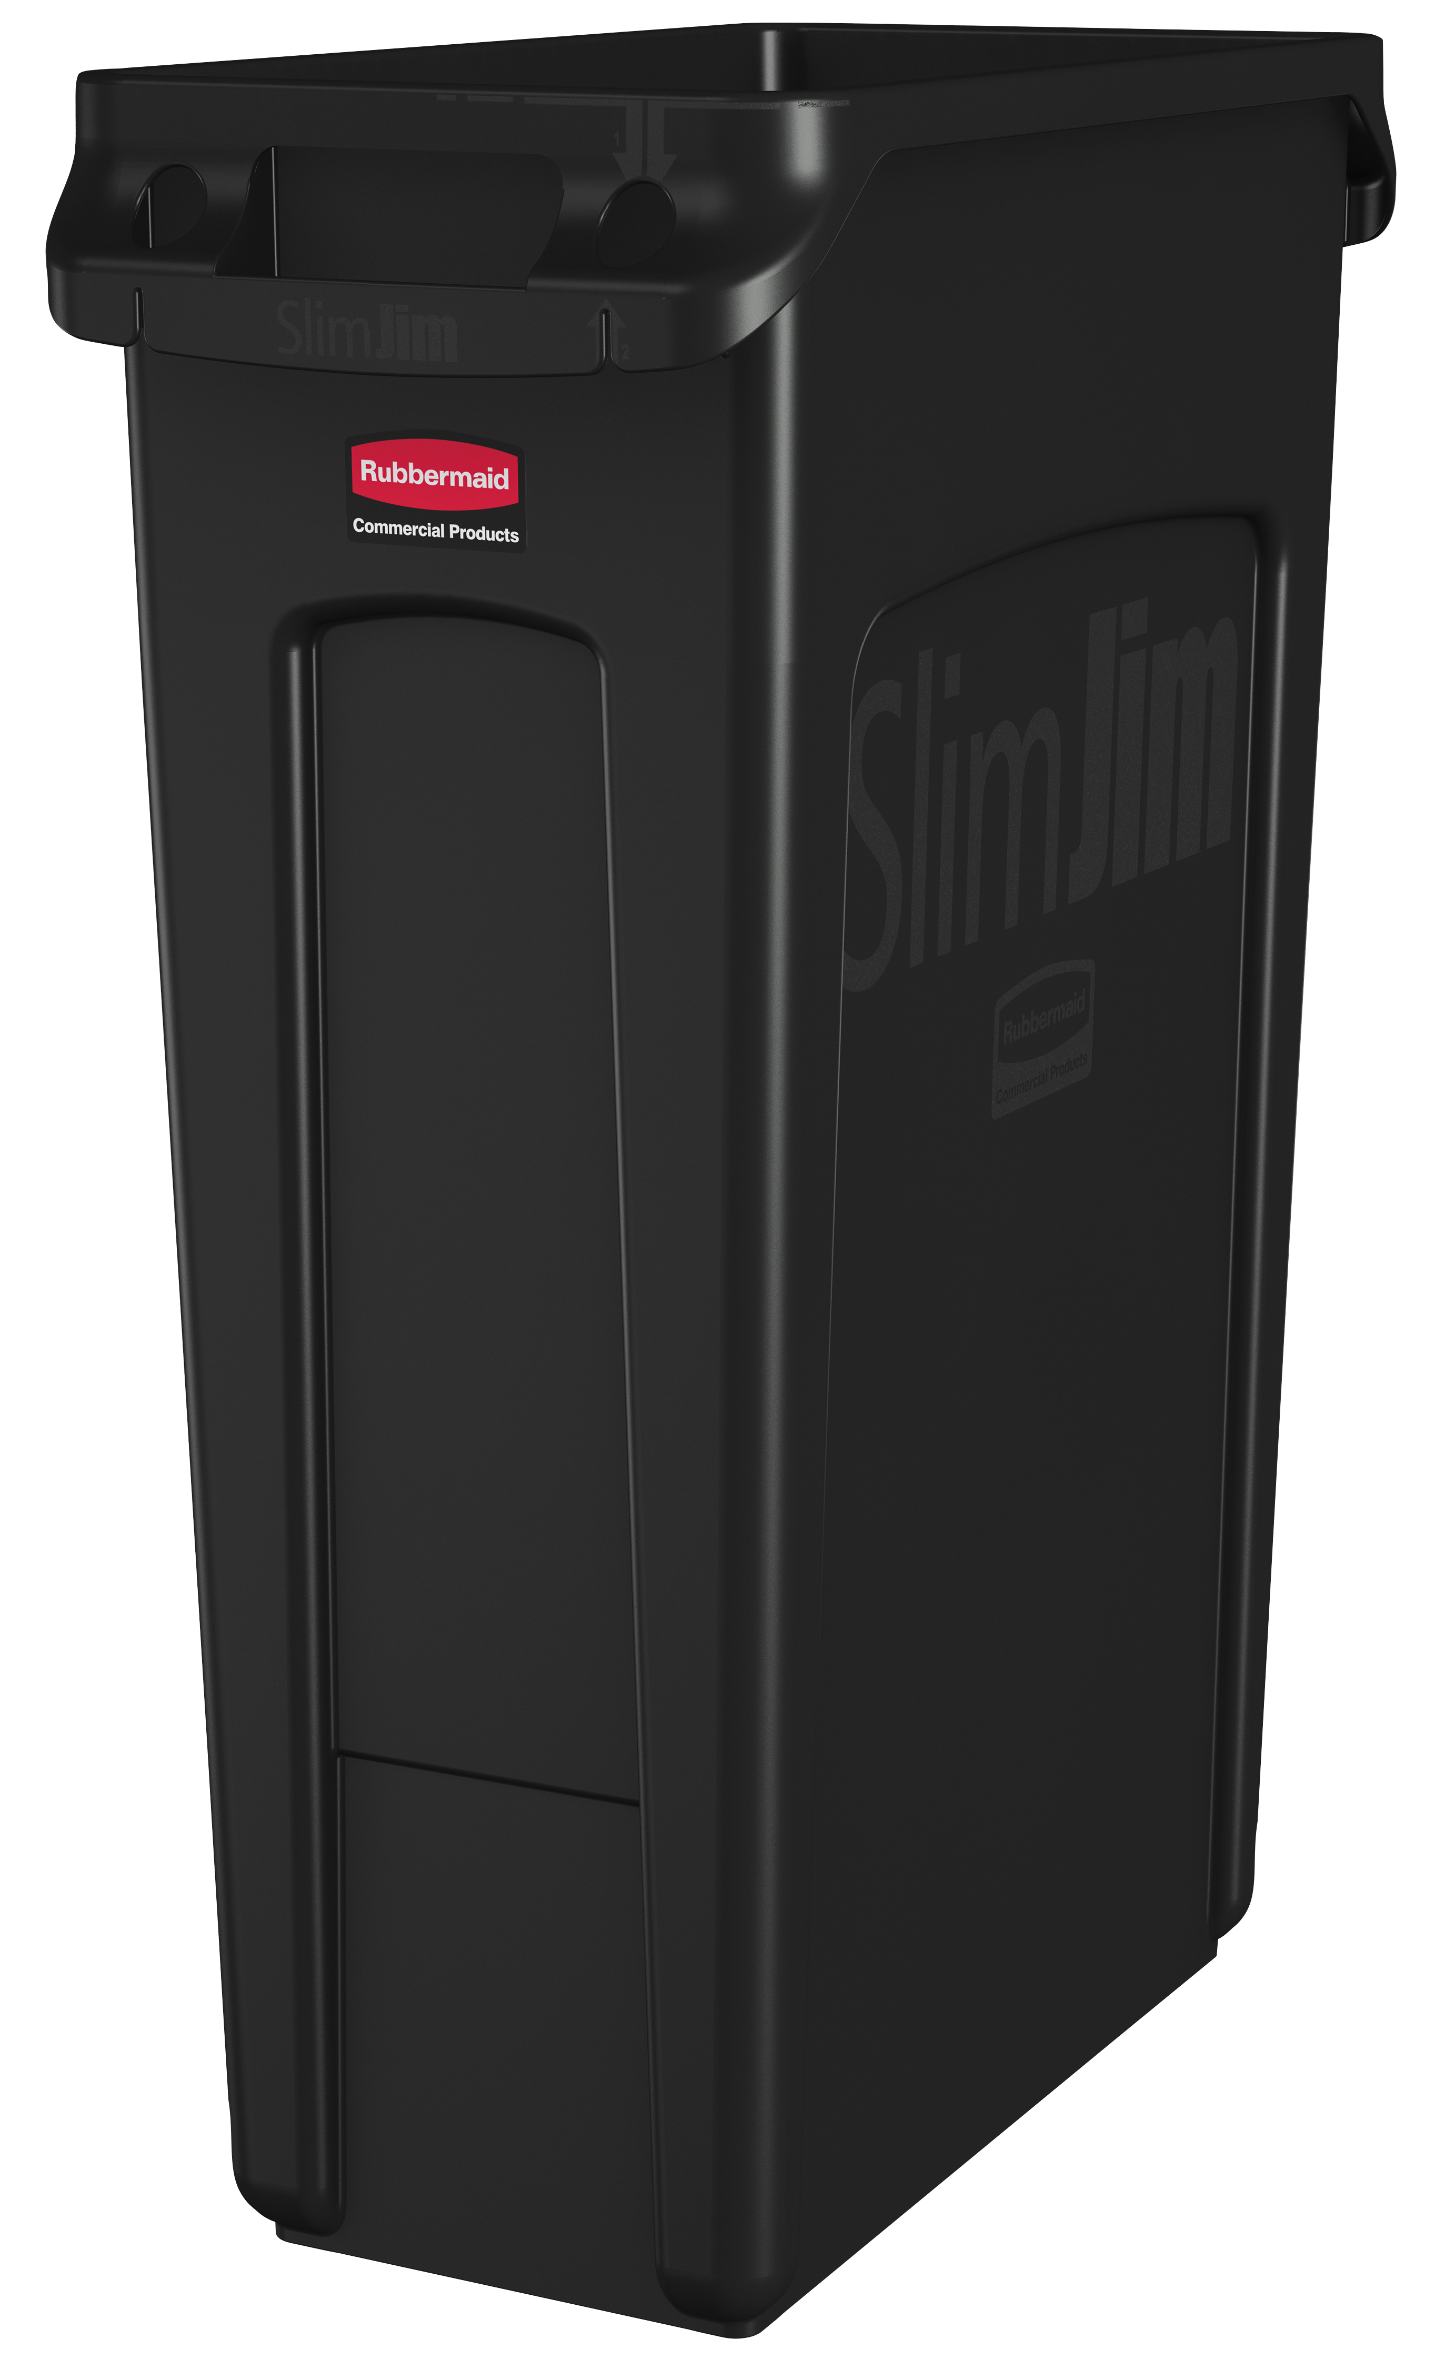
REFERENCE IMAGES FOR SLIDE 7
Place Company Logo Here
Delete Gray Box

Slide 11
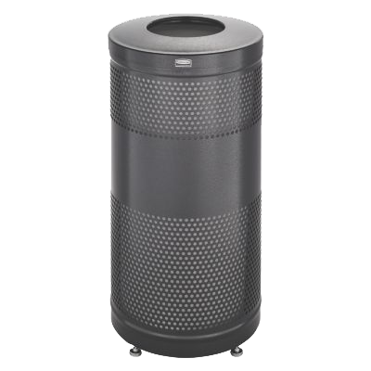
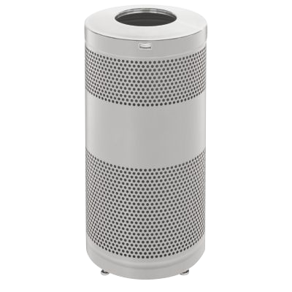
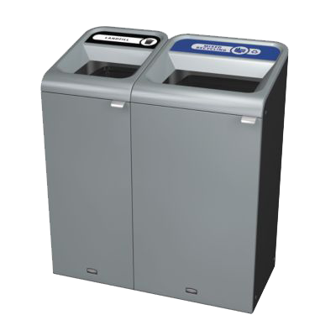
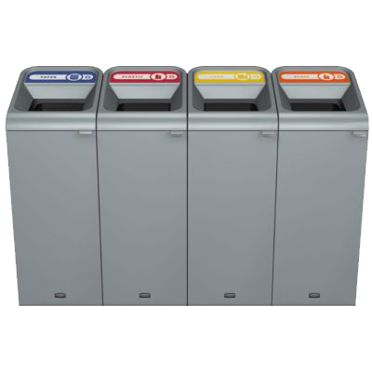
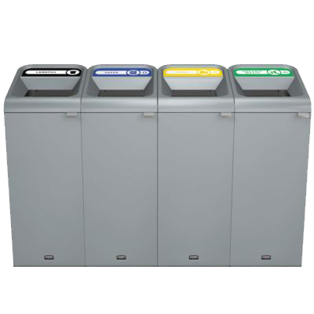
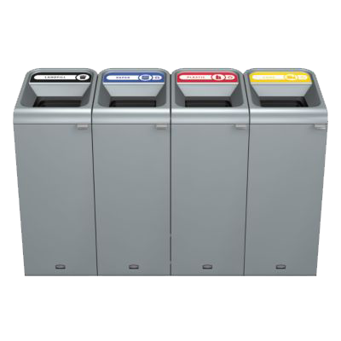
REFERENCE IMAGES FOR SLIDE 7
Place Company Logo Here
Delete Gray Box

