Slide 1

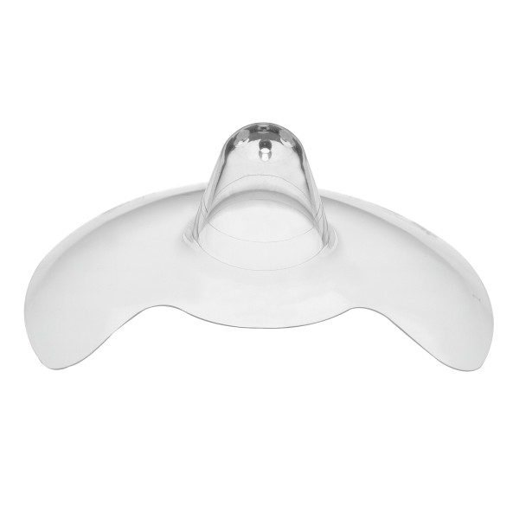
Contact™ Nipple Shields
Support when latching is difficult
Understanding Latch Challenges
Mothers may experience challenges such as difficulty latching, sore, cracked, or flat/inverted nipples.^{1,2} Contact™ Nipple Shields provide temporary support for breastfeeding when latching is difficult or painful, while also promoting healing.
Contact™ Nipple Shields
Unique shape maximizes skin-to-skin contact
Ultra-thin, flexible silicone maximizes nipple stimulation
Ideal for flat or inverted nipples
Pre-term and term infant sizing may vary
Multiple sizes of sterile and non-sterile versions available
Ordering Information
Legacy # | SAP # | Description | Quantity
67251S | 101028955 | Contact™ Nipple Shield – 16 mm (Sterile) | 20/cs
67218S | 101028958 | Contact™ Nipple Shield – 20 mm (Sterile) | 20/cs
67203S | 101028960 | Contact™ Nipple Shield – 24 mm (Sterile) | 20/cs
67251 | 101028963 | Contact™ Nipple Shield - 16 mm, Non-Sterile | 6/cs
67218 | 101028967 | Contact™ Nipple Shield - 20 mm Non-Sterile | 6/cs
67203 | 101028969 | Contact™ Nipple Shield - 24 mm, Non-Sterile | 6/cs
n/a | 101034109 | Contact™ Nipple Shield, 16 mm, with Storage Case (Retail Packaging, Non-Sterile) | 6/cs
n/a | 101034108 | Contact™ Nipple Shield, 20mm, with Storage Case (Retail Packaging, Non-Sterile) | 6/cs
n/a | 101034107 | Contact™ Nipple Shield, 24mm, with Storage Case Retail Packaging, Non-Sterile) | 6/cs
For more information, contact your Medela Sales Consultant
1. Kronborg H et al. Matern Child Nutr. 2017; 13(1). 2.Coentro VS et al. J Obstet Gynecol Neonatal Nurs. 2022; 51(1):73–82.
Medela wordmark and logo are registered in the U.S. Patent and Trademark Office and the Canadian Intellectual Property Office. 0625 © 2025 Medela

