Slide 1
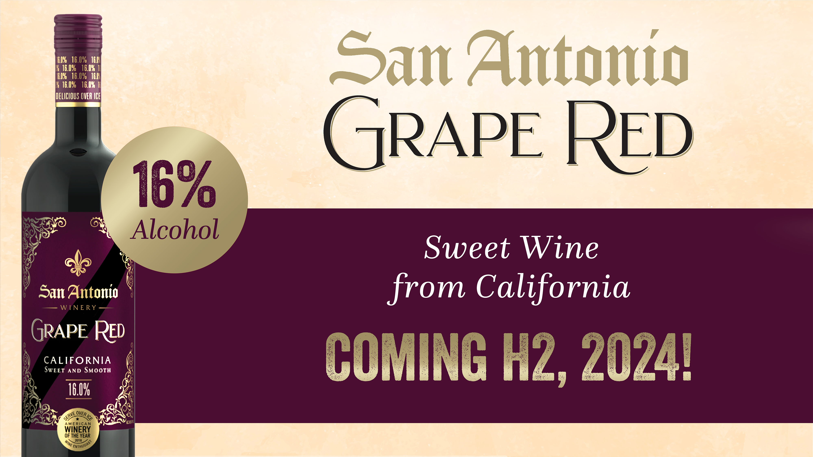

Slide 2
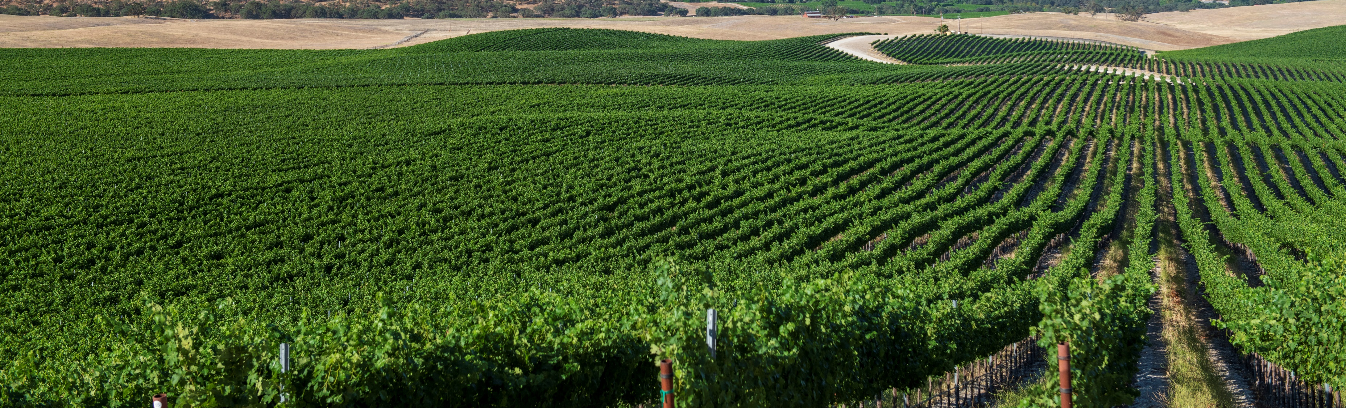
WHAT IS
SAN ANTONIO GRAPE RED?
San Antonio Grape Red is the latest addition to the San Antonio Wines collection. Crafted from pure Californian grapes, this naturally sweet wine boasts a bolder character thanks to its rich grape flavor and higher alcohol content. With notes of red berries and aromas of fresh plums and cherries, this sweet red wine pairs perfectly with a variety of appetizers and entrees or on its own as an after-dinner treat.

Slide 3
THE ENDURING LEGACY OF SAN ANTONIO WINES
San Antonio wines honor the Riboli family's Italian heritage, drawing inspiration from the Basilica of Saint Anthony of Padua to establish the renowned San Antonio name. The San Antonio wines journey began over fifty years ago with the launch of the highly successful San Antonio Cardinale, followed a few years later by the San Antonio Specialty collection featuring a sweet Moscato, a Rosé, and a semi-sweet red blend. These timeless wines resonated with post-prohibition America, where consumers craved sweeter, higher alcohol wines. Today, the Riboli family's legacy extends to the new San Antonio Grape Red, a naturally sweet wine crafted from pure California grapes. With notes of red berries and aromas of fresh plums and cherries, this sweet red wine pairs perfectly with a variety of appetizers and entrees or on its own as an after-dinner treat.

Slide 4
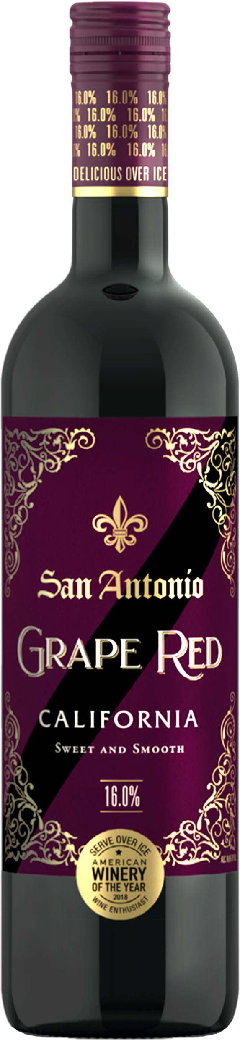



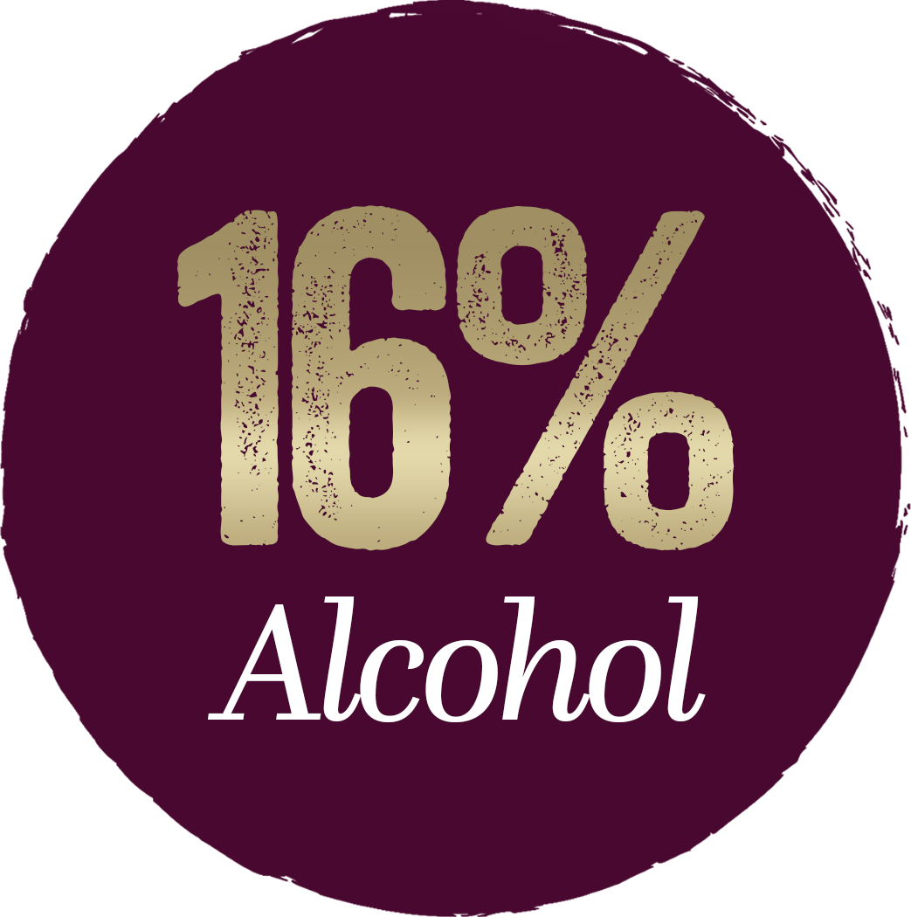

Flavor Profile: Sweet red blend with notes of red berries and aromas of plum and cherries.

Slide 5

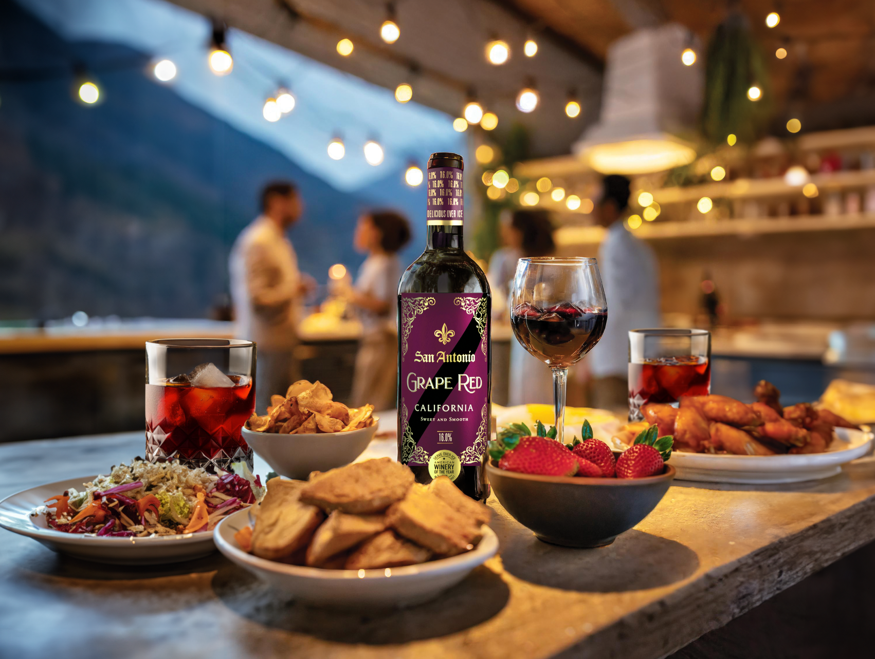



WHY SAN ANTONIO GRAPE RED
The demand for high alcohol wines is growing in the
US market. This trend presents a growth opportunity
for the San Antonio brand.
Since 2020, wines that are 15% ABV or higher, have consistently grown YoY.
In the last 52 weeks, wines that are 15% ABV or higher have grown over 10%.
At an affordable price point, the San Antonio Brand is a 175K (and growing) case brand with established brand loyalty and consumer trust.

Slide 6
EXECUTION STANDARDS
SRP
ITEM PLACEMENT
$11.99-12.99
Next to high ABV% wines comp set
In the cold box
Target 2 facings of San Antonio Grape Red to capture consumer’s attention.
Merchandise with San Antonio Grape Red POS to drive brand awareness.
Highlight the high ABV% and flavor profile of the wine.

Slide 7
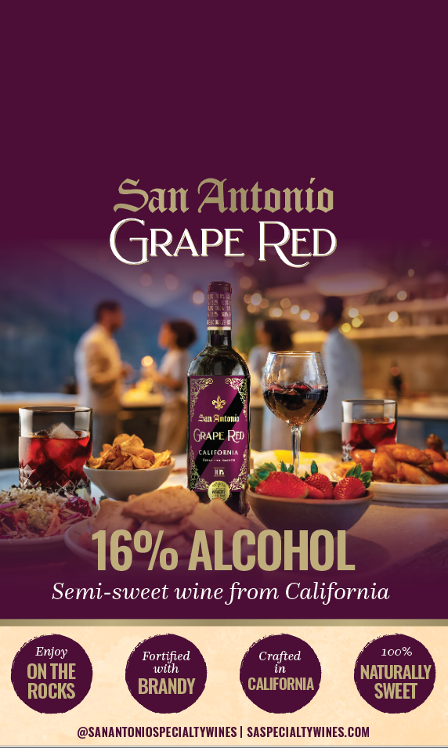
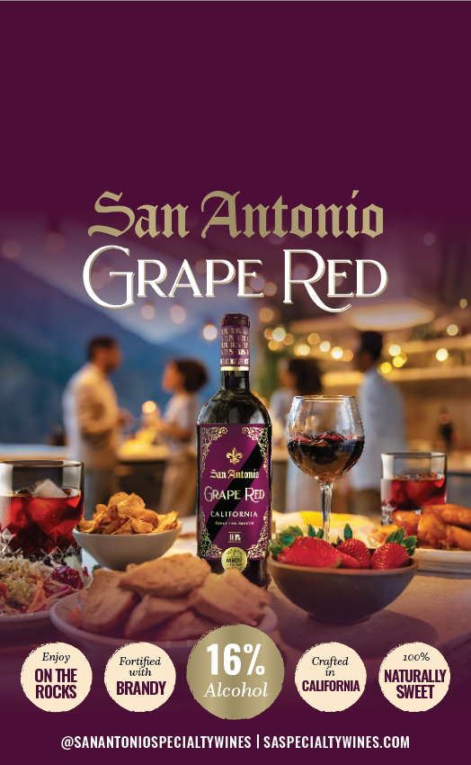
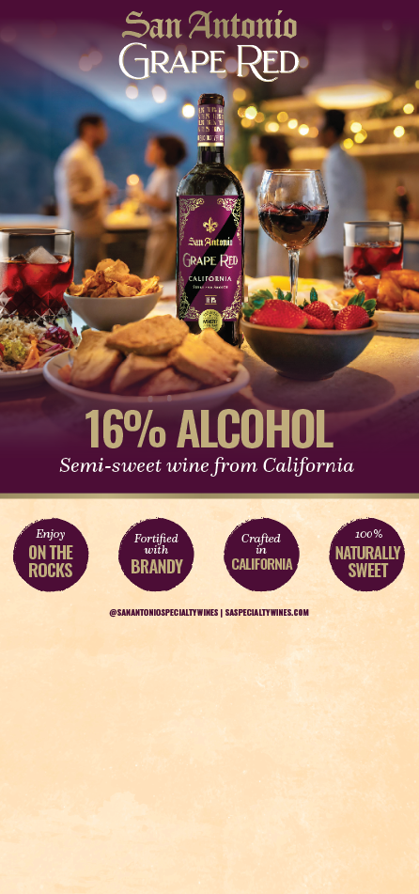
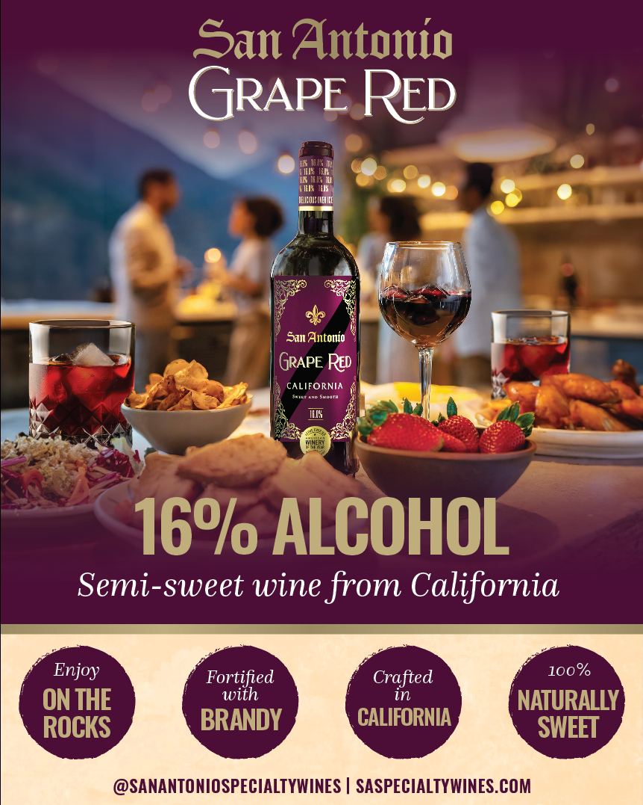
TRADE MARKETING POS - FPO
Shelf Tucker
Case Tucker
Cold Box Decals
Case Card

